Slide 1
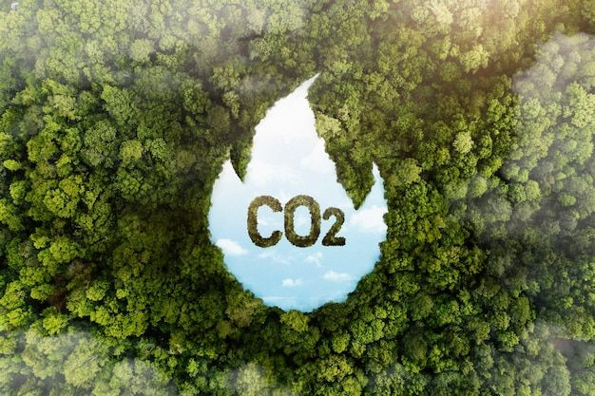
Co2 Emissions By Sectors Analysis
Presented By:- Ankit Rajak
Project File:-Co2 Emissions Project Analysis

Slide 2
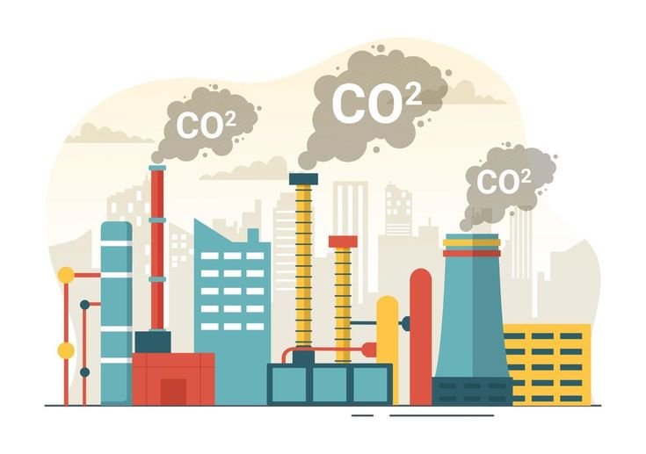
Introduction:-
CO2 emissions, or carbon dioxide emissions, refer to the release of carbon dioxide into the atmosphere, primarily from human activities such as burning fossil fuels for energy, transportation, and industrial processes. CO2 is a major greenhouse gas, contributing significantly to global warming and climate change by trapping heat in the Earth's atmosphere. As the global demand for energy and resources continues to rise, CO2 emissions have reached unprecedented levels, posing serious environmental, economic, and social challenges.
The primary sources of CO2 emissions include coal, oil, and natural gas combustion, deforestation, and various industrial activities like cement production. The increasing concentration of CO2 in the atmosphere leads to rising global temperatures, melting ice caps, rising sea levels, and more frequent extreme weather events.
Efforts to reduce CO2 emissions focus on transitioning to renewable energy sources, improving energy efficiency, and implementing sustainable practices across industries. Understanding the causes, impacts, and solutions to CO2 emissions is critical for combating climate change and promoting a healthier, more sustainable planet for future generations.

Slide 3
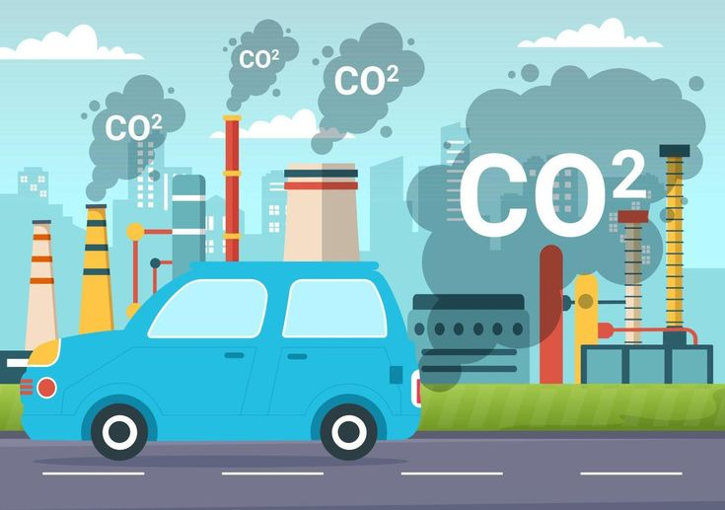
Objective:-
CO2 emissions are a critical contributor to climate change, and analyzing emissions by sector helps identify the largest sources and potential areas for improvement. The key sectors contributing to CO2 emissions include energy production, industry, transportation, agriculture, and residential and commercial buildings.
Energy production is the largest emitter, primarily from burning fossil fuels like coal, oil, and natural gas for electricity generation. This accounts for a significant portion of global CO2 emissions, as energy is needed across all other sectors.
Industry contributes heavily through the manufacturing of cement, steel, and chemicals, which require high energy consumption and result in significant emissions.
Transportation, including cars, trucks, airplanes, and ships, relies heavily on petroleum-based fuels. The sector’s emissions have been steadily increasing due to global mobility and economic growth.
Agriculture and land-use changes, such as deforestation, contribute to emissions through livestock methane production, soil degradation, and the clearing of forests that absorb CO2.
Finally, residential and commercial buildings contribute through energy use for heating, cooling, and electricity. Improving efficiency in these sectors, along with transitioning to renewable energy sources and sustainable practices, is crucial for reducing overall CO2 emissions and mitigating climate change.

Slide 4
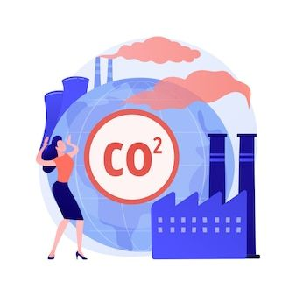
Key Questions:-
Find Out The Co2_Emissions_MetricTons.
Find Out The Energy Consumption TWH.
Find Out The Automobile_Co2_Emissions_MetricTons.
Find Out The Industrial_Co2_Emissions_MetricTons.
Find Out The Agriculture_Co2_Emissions_MetricTons.
Find Out The Domestic_Co2_Emissions_MetricTons.
Find Out The Population.
Find Out The GDP Billion USD.
Find Out The Urbanization Percentage.
Find Out The Renewable Energy Percentage.
Find Out The Industrial Growth Percentage.
Find Out The Transport Growth Percentage.

Slide 5
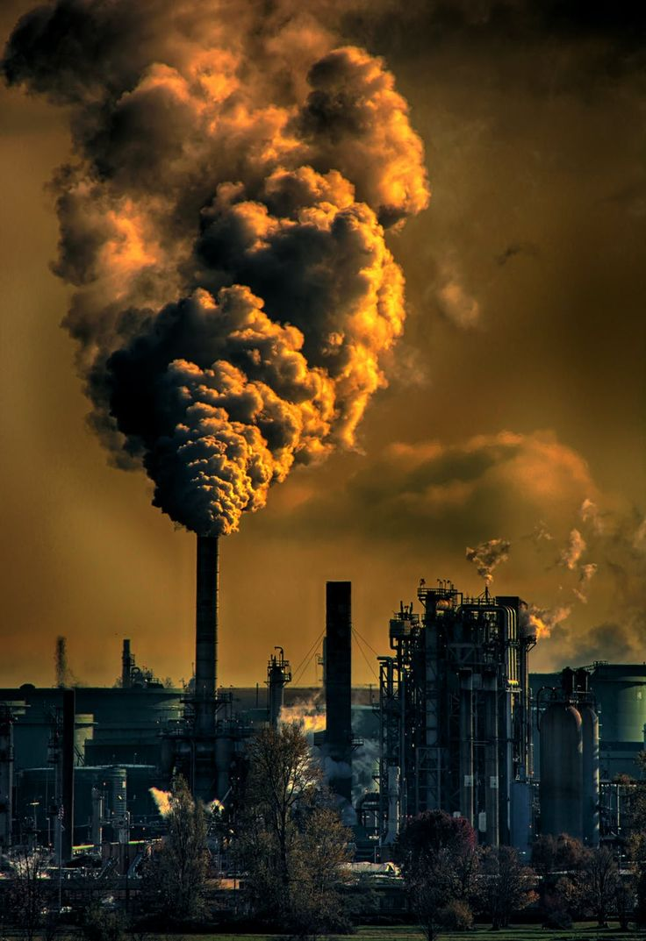
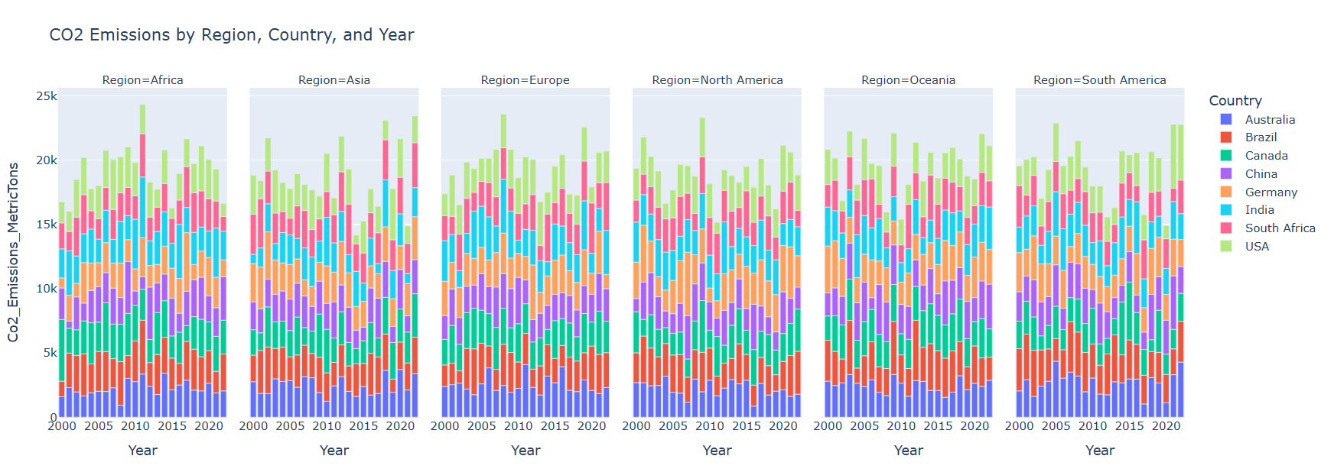
1.Find Out The Co2_Emissions_MetricTons.
Observation:-CO2 Emissions (Metric Tons) is a measure of the total amount of carbon dioxide released into the atmosphere from various activities, expressed in metric tons. It quantifies emissions from sources like energy production, transportation, and industrial processes, providing a standard unit for comparing environmental impacts across sectors.

Slide 6
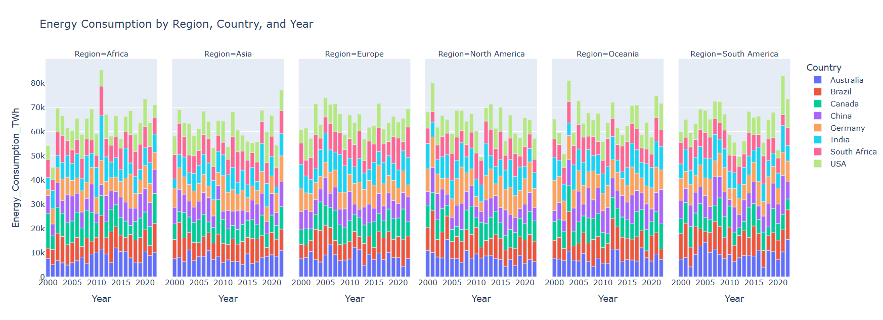
2.Find Out The Energy Consumption TWH.
Observation:- Energy Consumption (TWH) refers to the total amount of energy used, measured in terawatt-hours (TWH). One terawatt-hour equals one trillion watt-hours. This metric is used to quantify energy usage across sectors such as electricity generation, industry, and transportation, providing insights into global and regional energy demand and efficiency.

Slide 7

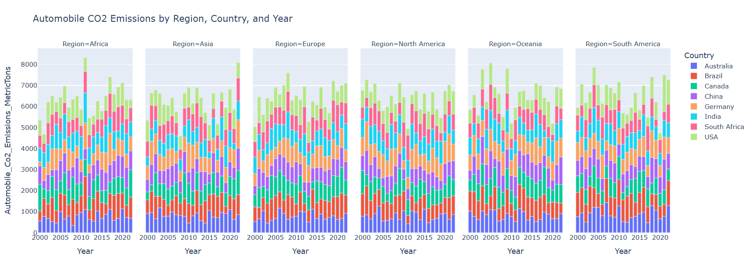
3.Find Out The Automobile Co2 Emissions MetricTons.
Observation:-Automobile CO2 Emissions (Metric Tons) represent the amount of carbon dioxide released by vehicles, including cars, trucks, and buses, during fuel combustion. Measured in metric tons, these emissions contribute significantly to global CO2 levels, mainly from burning gasoline or diesel, making the transportation sector a major emitter globally.

Slide 8
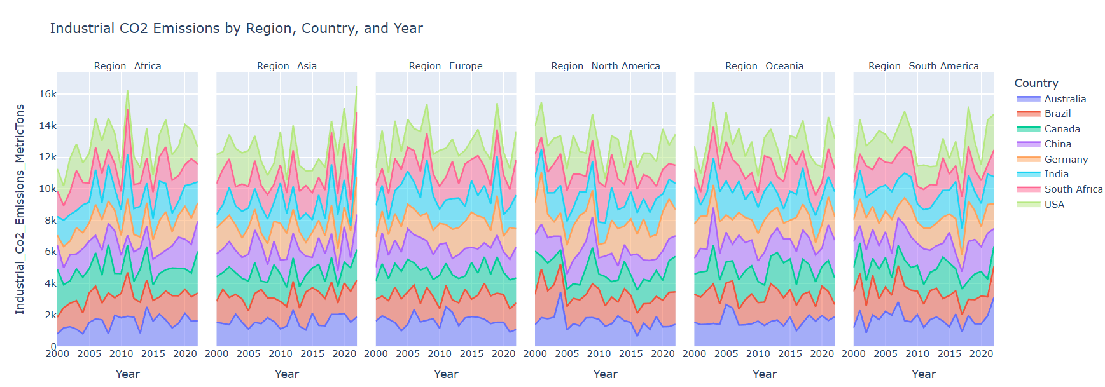
4.Find Out The Industrial Co2 Emissions Metrictons.
Observation:-Industrial CO2 Emissions (Metric Tons) refer to the carbon dioxide released from manufacturing and production processes, including cement, steel, and chemical industries. Measured in metric tons, these emissions result from energy use, raw material processing, and waste generation, making industry one of the largest contributors to global CO2 emissions.

Slide 9
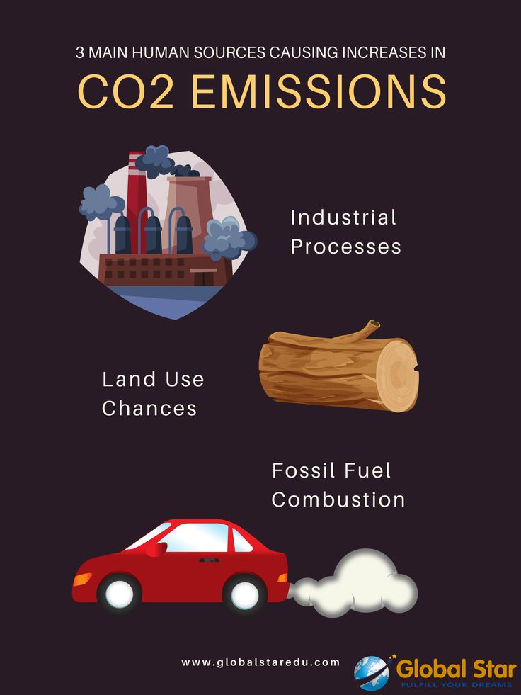
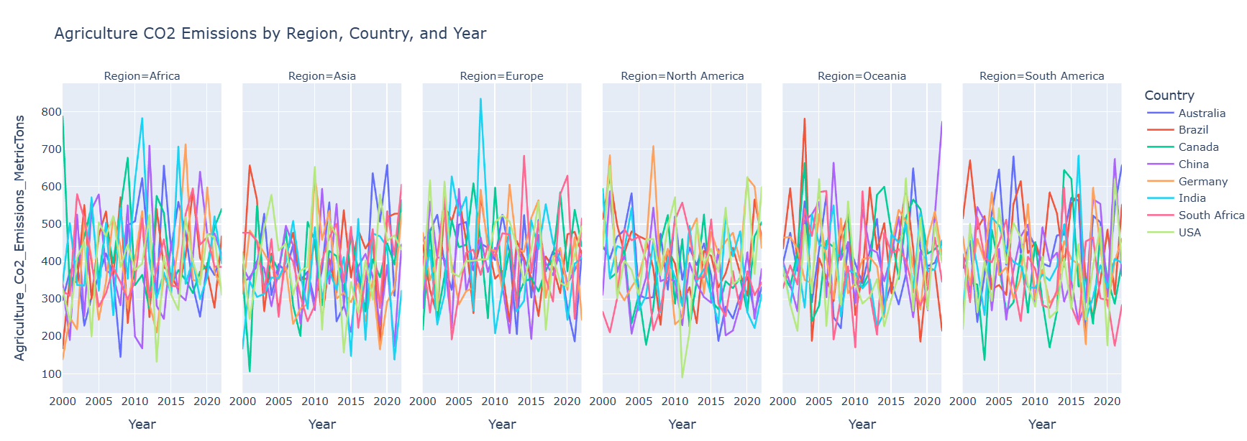
5.Find Out The Agriculture Co2 Emissions MetricTons.
Observation:-Agriculture CO2 Emissions (Metric Tons) refer to the carbon dioxide released from farming activities, such as land-use changes, deforestation, and soil management. Though agriculture's direct CO2 emissions are lower than other sectors, it contributes indirectly through methane (CH4) and nitrous oxide (N2O), making it a significant contributor to greenhouse gases.

Slide 10
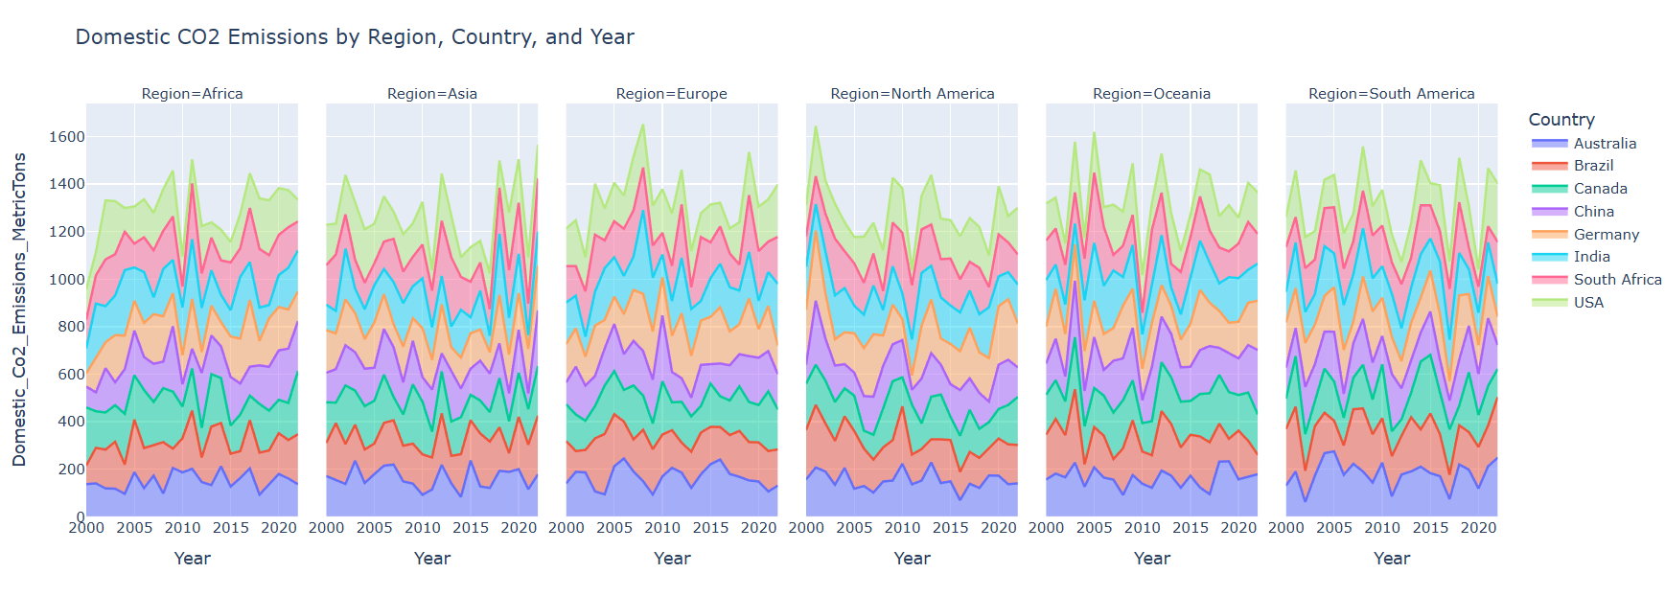
6.Find Out The Domestic Co2 Emissions Metric tons.
Observation:-Domestic CO2 Emissions (Metric Tons) refer to the carbon dioxide produced from residential energy use, including heating, cooling, and electricity consumption. These emissions result from burning fossil fuels like natural gas, oil, or coal in homes. Improving energy efficiency and using renewable energy can significantly reduce domestic emissions.

Slide 11
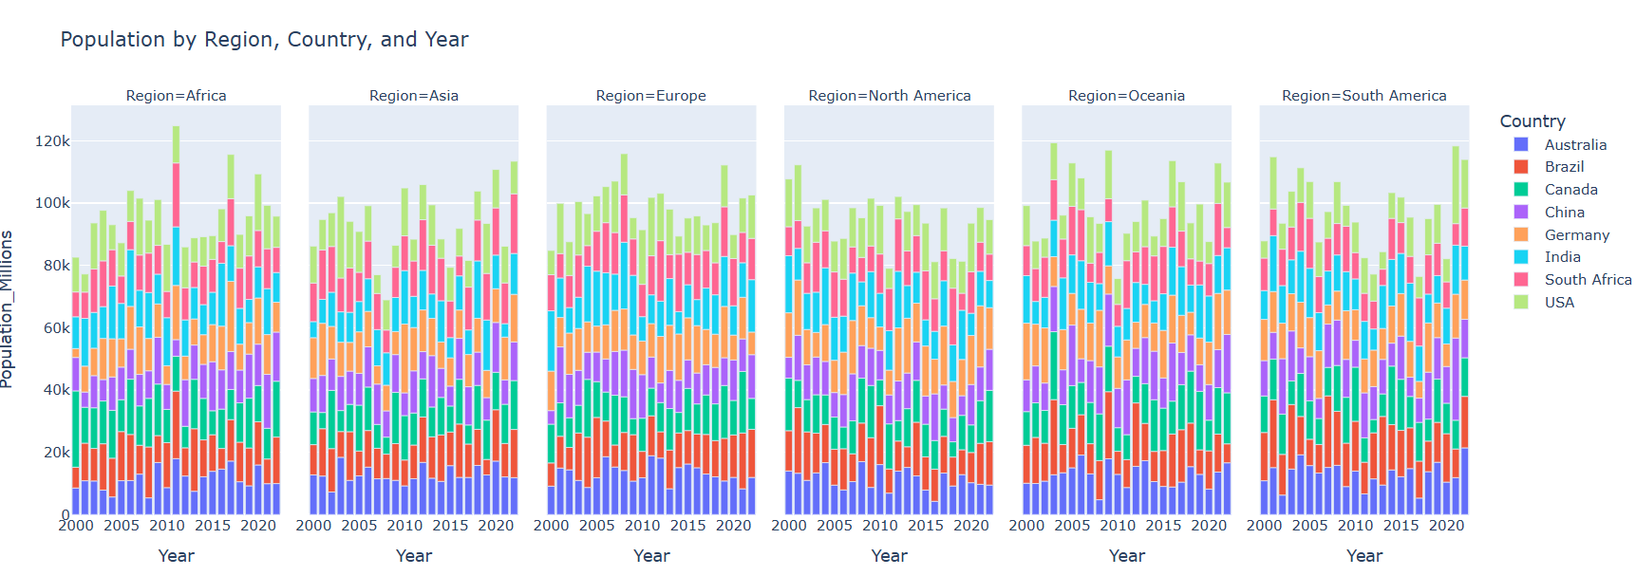
7.Find Out The Population.
Observation:-Population CO2 refers to the total carbon dioxide emissions attributed to a population, often calculated per capita. It measures the average emissions generated by an individual, accounting for energy use, transportation, and consumption habits. As populations grow, so do emissions, making it a key factor in climate change discussions.

Slide 12
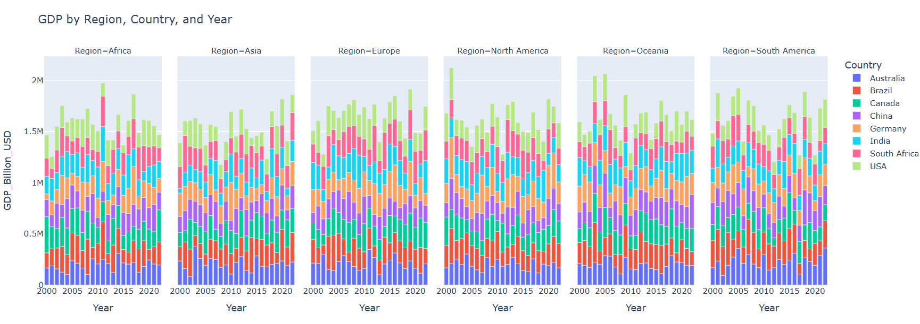
8.Find Out The GDP Billion USD.
Observation:-GDP (Gross Domestic Product) in Billion USD represents the total value of goods and services produced by a country within a specific period, usually a year, expressed in billions of U.S. dollars. It’s a key indicator of a nation’s economic health, reflecting productivity, income levels, and overall economic performance.

Slide 13
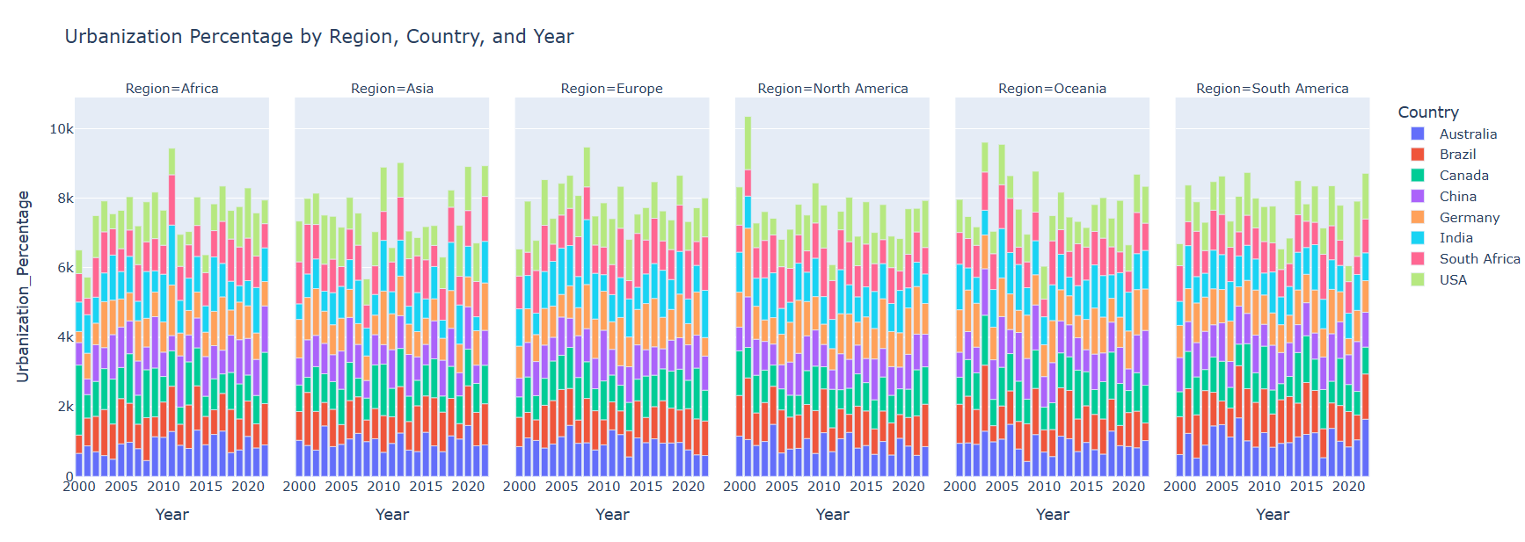
9.Find Out The Urbanization Percentage.
Observation:-Urban areas are significant contributors to global CO₂ emissions, accounting for approximately 71% to 76% of emissions from final energy use. IPCC
This high percentage is due to concentrated energy consumption in transportation, buildings, and industry within cities. As urbanization continues, the share of global CO₂ emissions from urban areas is expected to rise, underscoring the need for sustainable urban planning and energy-efficient infrastructure.

Slide 14
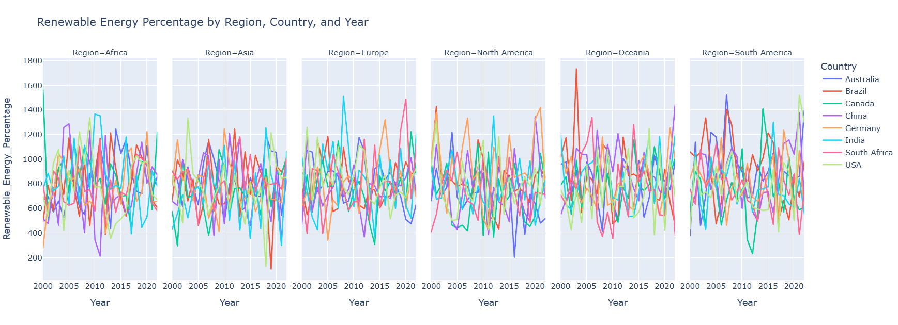
10.Find Out The Renewable Energy Percentage.
Observation:-Renewable energy sources, such as solar, wind, and hydropower, are essential for reducing CO₂ emissions. In 2022, the global power sector's CO₂ emissions decreased due to a 10% increase in renewable energy production. World Economic Forum
However, fossil fuels still account for a significant portion of global CO₂ emissions. IER
Transitioning to renewable energy is crucial for achieving substantial reductions in CO₂ emissions.

Slide 15
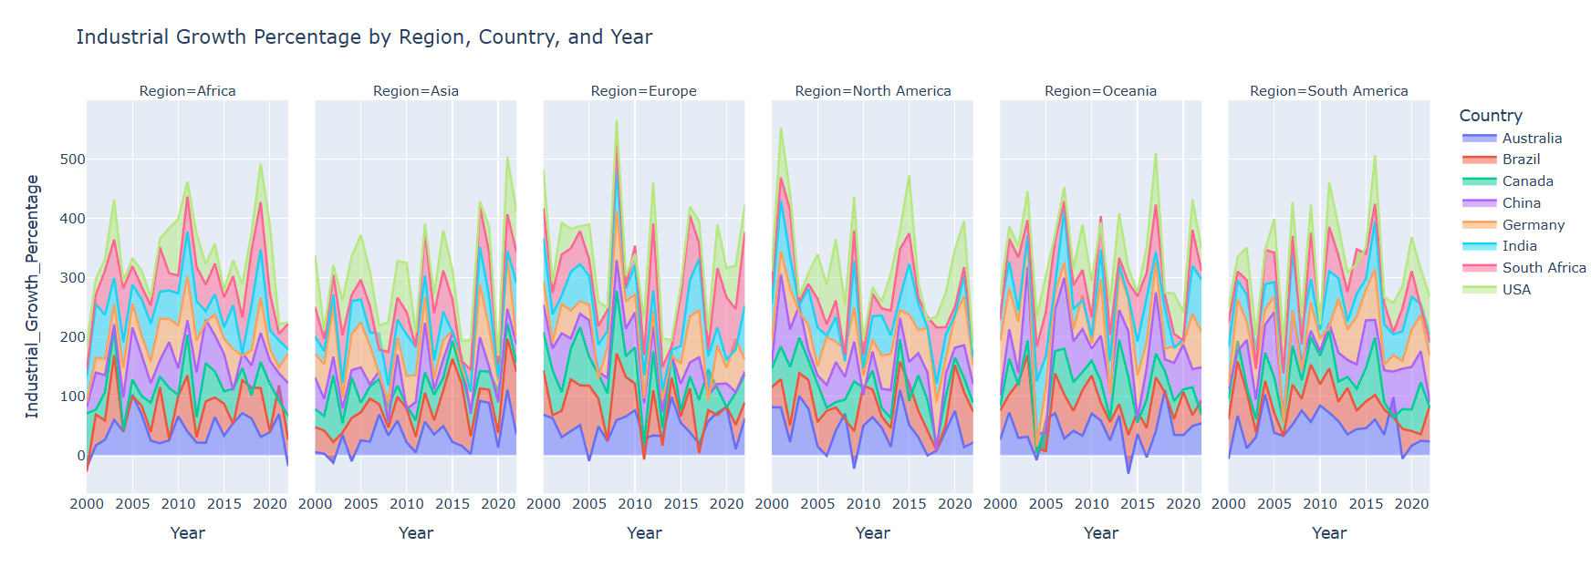
11. Find Out The Industrial Growth Percentage.
Observation:-Industrial growth has historically been closely linked to increased CO₂ emissions. Since the Industrial Revolution, global CO₂ emissions have risen significantly, reaching over 35 gigaton-es per year. Statista
In 2022, energy-related CO₂ emissions grew by 0.9%, reaching a new high of over 36.8 gigaton-es. IEA
However, the manufacturing sector's emissions are projected to increase by 17% between 2024 and 2050, driven by growth in emissions-intensive industries. Congressional Budget Office
This underscores the need for sustainable industrial practices to mitigate CO₂ emissions.

Slide 16
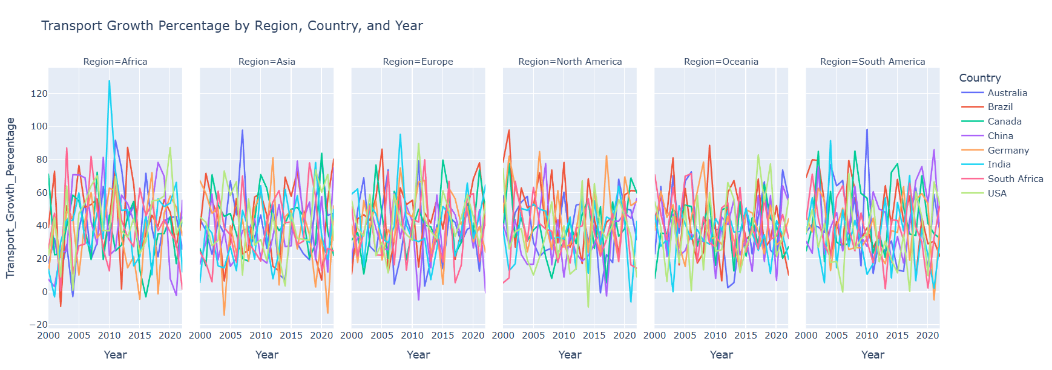
12.Find Out The Transport Growth Percentage.
Observation:-In 2023, global transportation-related carbon dioxide (CO₂) emissions increased by 4% to 8.24 billion metric tons, marking the highest level to date. Statista
This rise is attributed to factors such as increased travel demand and economic activities, underscoring the need for sustainable transportation solutions.

Slide 17
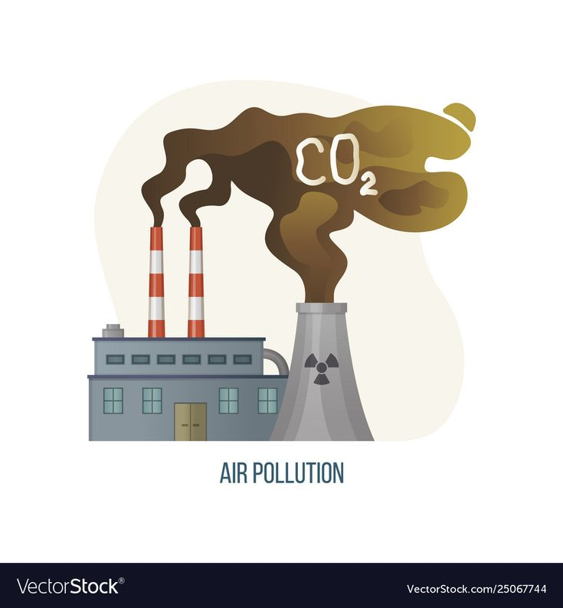
Conclusion:-
CO₂ emissions by sector reflect the global reliance on carbon-intensive activities and the need for systemic change. The largest contributor to global CO₂ emissions is the energy sector, accounting for around 73% of emissions. This is driven by the burning of fossil fuels for electricity, heat, and transportation. Within energy, electricity and heat production contribute the most, followed by transport.
The transportation sector alone contributes about 16% of global CO₂ emissions, with road transportation being the most significant source due to the extensive use of gasoline and diesel-powered vehicles. This is followed by emissions from aviation and shipping, which are rapidly increasing, especially with the global growth in goods movement and international travel.
The industrial sector contributes roughly 19% of global CO₂ emissions, with cement, steel, and chemical production being the major offenders. These industries are energy-intensive and often rely on fossil fuels for production processes.
Agriculture, forestry, and land use account for approximately 18% of emissions, primarily through deforestation, methane emissions from livestock, and rice paddies.
To reduce global CO₂ emissions, transitioning to renewable energy, improving energy efficiency, and adopting sustainable agricultural practices are critical. Additionally, shifting towards electric vehicles and promoting low-carbon industrial processes can significantly mitigate emissions.

Slide 18
Thank You

